Slide 1
How Technology Facilitates Modernizing Intro Stat
What’s In, What’s Out
(For Beginners)
Patti Frazer Lock
Cummings Professor of Mathematics
St. Lawrence University
Canton, New York
Joint Mathematics Meetings
January 2020

Slide 2
The Future of Intro Stats
There is a revolution going on in this course, across the country and across all types of institutions
Driven by advances in technology
Potential to dramatically enhance student learning and student enjoyment and student success

Slide 3
The Future of Intro Stats: Service Courses
Lots of desire and pressure to reduce prerequisites
Lots of effort in exploring multiple pathways to success
Intro Stats can be an accessible and interesting service course. We can help many more students succeed.
Intro Stats is important for virtually all STEM fields, but also for good citizenship and for all students

Slide 4
The Future of Intro Stats: Courses for Math/Stat/CS Majors
MAA recommends that all math majors take an applied data analysis course as a part of the major program
Mathematical preparation of teachers requires knowledge of applied data analysis
Math graduates will be expected to know applied data analysis
A strong Intro Stat course can attract students to Math and Stat and CS.
Math departments across the country are often failing to meet this goal.

Slide 5
The Future of Intro Stats
What kind of an Intro Stat course can better meet the needs of all our students?
What’s In; What’s Out

Slide 6
What’s in?
Everything in the GAISE Report!
(Thank you, Beverly!)

Slide 7
What’s out?
Thinking of Intro Stat as a low-level math service course focused on procedures and formulas.
Thinking of Intro Stat as a high-level theoretical course in probability and mathematical statistics.

Slide 8
What’s in?
Thinking of Intro Stat as a vibrant introduction to the very rapidly growing field of
Applied Data Analysis

Slide 9
What’s Out?
Computing standard deviation by hand
Drawing any graph by hand
Probability Rules
General Density Functions
Moment Generating Functions
Hypergeometric Distribution

Slide 10
What’s In?
Effective collection of data
Effective analysis of data
Interpreting and communicating results
Focusing on key ideas of variability and strength of evidence
Statistical software and effective technology use!
Introducing students to the fun of learning from data!

Slide 11
Intro Stats: Not This
Consider two events A and B, and assume that P(A) = 0.6 and P(B) = 0.5 and P(A∩B) = 0.2.
Find P(A∪B).

Slide 12
Intro Stats: But This
Are mosquitoes more attracted to beer drinkers?
Does leaving a light on at night affect weight?
Does diet cola leach calcium out of the system?
Does drinking red wine boost metabolism?
Does radiation from cell phones affect brain activity?
Are lions more likely to attack after a full moon?
Do people read faster from a printed book than from an iPad or Kindle?
Does tagging penguins for identification purposes harm them?
Does turning up the music in a bar increase beer consumption?
Are city dwellers more likely to have mood and anxiety disorders?
Are the youngest kids in a class more likely to be diagnosed with ADHD?
Is there a “commitment” gene?
Can dogs smell cancer in humans?
Does sexual frustration increase the desire for alcohol?
How broadly do experiences of parents affect their future children?
What percent of college professors consider themselves “above average” teachers?
AND SO ON!

Slide 13
What’s in?
Helping more students succeed at and understand and enjoy Intro Stats.

Slide 14
HOW???
Increased Effective Use of Technology
Decreased Emphasis on Algebra

Slide 15
Activity: Imagine Flipping a Coin
Write down a sequence of ten Heads and Tails (H’s and T’s) that might result from 10 flips of a fair coin.
Now: Ignore all but the first “flip”. Did you write H or T as the first thing in your sequence?

Slide 16
Our Data:
That’s a lot more Heads than Tails!!
Does this result provide evidence that I manipulated you by saying “Heads” first in the instructions?

Slide 17
We don’t expect exactly 50% heads and 50% tails.
Is our proportion of heads farther off than we might expect by random chance?
We can find out!
(using technology, of course!)

Slide 18
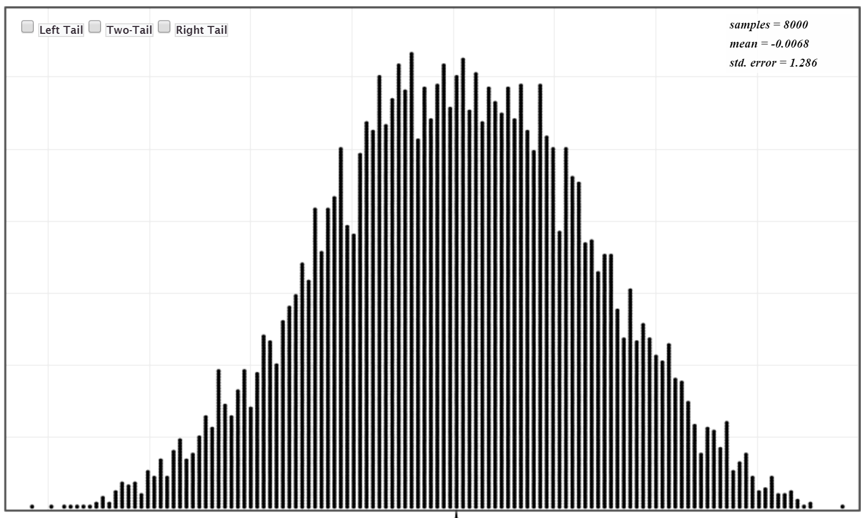
Random variation in proportion of heads if a fair coin is flipped.
Our sample statistic way out here:
Unlikely to be just random chance!
There is evidence I manipulated you!

Slide 19
Random variation in proportion of heads if a fair coin is flipped.
Our sample statistic here:
Could be just random variation.
Not enough evidence to make a clear conclusion.

Slide 20
STATKEY!!
www.lock5stat.com/statkey
(Free, online, works in any browser)

Slide 21
There is evidence I manipulated you!
What about “Tails and Heads”?
What about Purple and Orange? Or Orange and Purple?
(This is a really fun, and quick, activity to do in class. ☺)

Slide 22
Sampling Variation
Observed statistic here: Or here:
Strength of Evidence

Slide 23
Technology allows us to do this simulation-based inference.
Visual; Intuitive
Ties directly to key concepts
Very minimal algebra
Deeper understanding

Slide 24
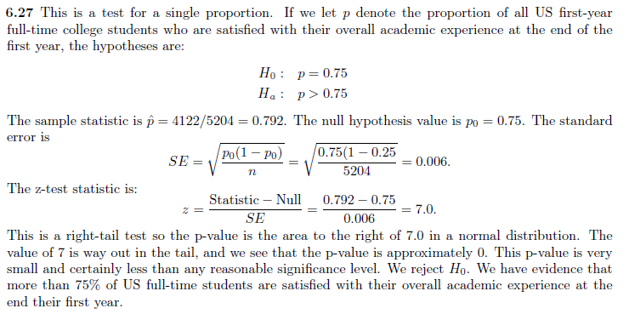
Traditional Methods
To lots of our students:
THIS is a “black box”.

Slide 25
Technology allows us to modernize the course in many other ways too.
Including Multiple Variables
Including more advanced Data Visualization!

Slide 26
Data Visualization
of Multiple Variables!
One example:
www.gapminder.org/tools

Slide 27
Data Visualization
of Multiple Variables!
www.gapminder.org
Student Engagement
Play the animation in class (maybe multiple times)
Ask students: what are the cases? What are the variables?
Have students explain the general trend
Have students explain the “dips”
Have students pick two new variables and play it again
Assign it for homework
Have students pick one country and describe how the variables change over time for that country
Have students pick their own two variables and write a paragraph describing what they see in the data for those two variables.
Many more ideas!

Slide 28
Data Visualization
of Multiple Variables!
(So Many Other Ideas)
What’s Going On In This Graph?
Weekly, NYTimes/ASA
Correlation Guessing Game
www.istics.net
Google Trends
And so on.

Slide 29
Data Visualization
of Multiple Variables!
(So Many Other Ideas)
Have a data visualization contest!!
Students find their own and describe it.
Requires and builds deeper understanding of data.
Algebra is not a barrier.
It is fun!

Slide 30
Modern Intro Stats Course
Course Requirements:
Location:
Computer Classroom
OR: Traditional classroom with Lab
OR: Traditional classroom
OR: No classroom (online)
Pre-requisites:
Very basic math
(NOT COLLEGE ALGEBRA!)
(Certainly not Calculus!)

Slide 31
Modern Intro Stats Course
Course Requirements: (continued)
Technology: Free, easy, online applets
(StatKey, RossmanChance, CODAP, …)
OR: Purchased statistical software
(Minitab, JMP, etc. …)
OR: Free powerful statistical software
(R and friends)
Audience: Students satisfying math requirement
Students in user disciplines
Math/CS/Stat Majors

Slide 32
Technology Allows us to Teach a Modern Intro Stats Course that is:
Deep and Rigorous (and focused on data)
Appropriate and valuable for math majors
Appropriate and necessary for math-ed majors
A better course for all user disciplines
Accessible for many more students and allows many more students to succeed
A course that attracts students to STEM
Fun and engaging and overtly relevant
Fun to teach!

Slide 33
Thanks for listening!
plock@stlawu.edu
www.lock5stat.com

